Slide 1

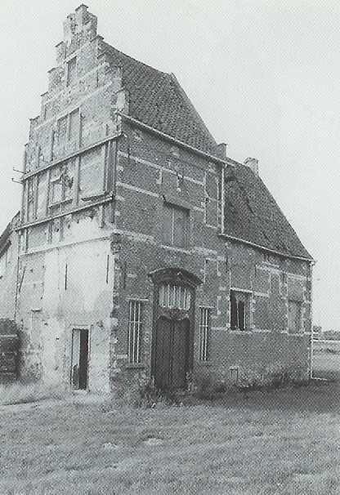




45min
UI/UX
Don’t Make Me Think
Theoretical
Introduction
FrontendTrack

Slide 2


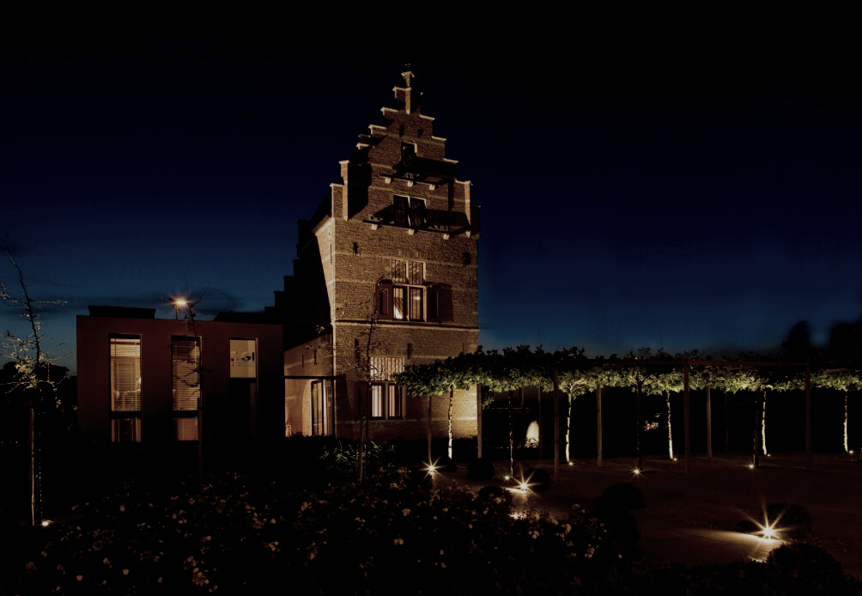

Jakob Nielsen
The human brain’s capacity doesn’t change from one year to the next, so the insights from studying human behavior have a very long shelf life.
What was difficult for users twenty years ago continues to be difficult today.

Slide 3

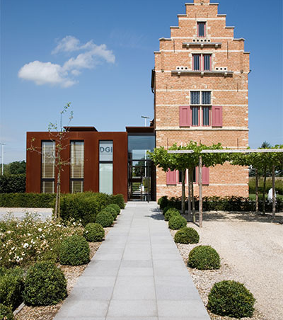

Menu
Why
What
User Behavior
Billboard Design
Usability Testing
Common Courtesy
Other Chapters
More Resources

Slide 4



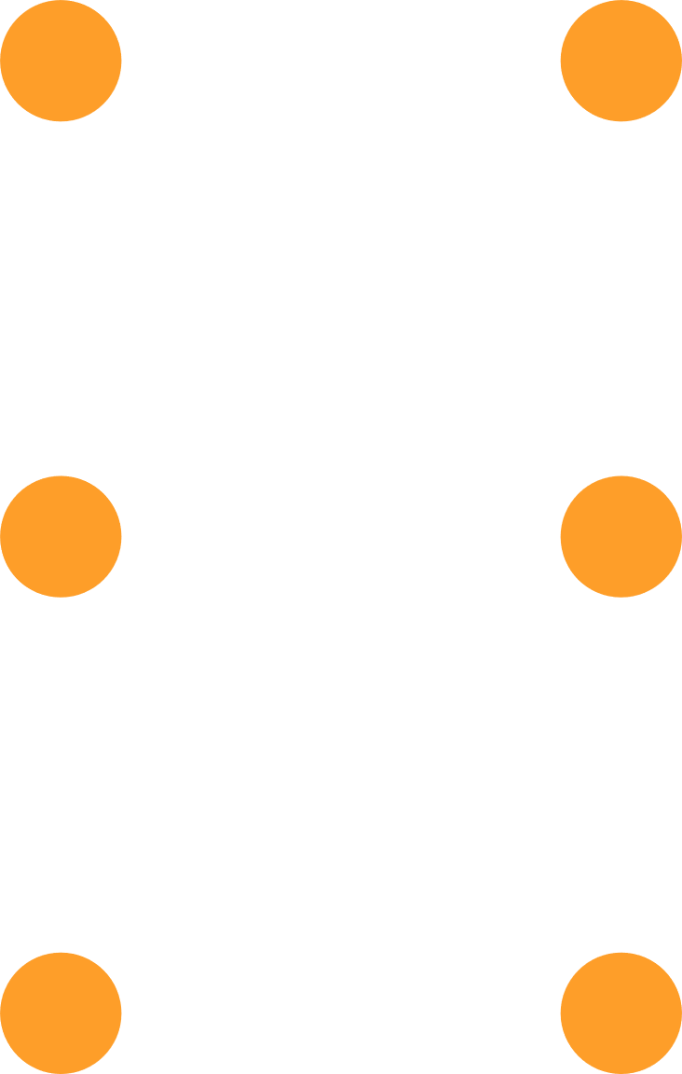
Why
BAD NEWS: There is no Usability Expert on your team.
GOOD NEWS: It’s not rocket surgery.

Slide 5

What
Book by Steve Krug, 2013
“Advanced Common Sense”
Just 190 pages
Notes:
Advanced Common Sense:
Consultancy of Krug. Motto: “It’s not rocket surgery”

Slide 6
What
A person of average (or even below average) ability and experience can figure out how to use the thing to accomplish something without it being more trouble than it’s worth

Slide 7
What
No hard and fast usability rules
But there is a first law of usability
The ultimate tie-breaker
Don’t make me think!

Slide 8
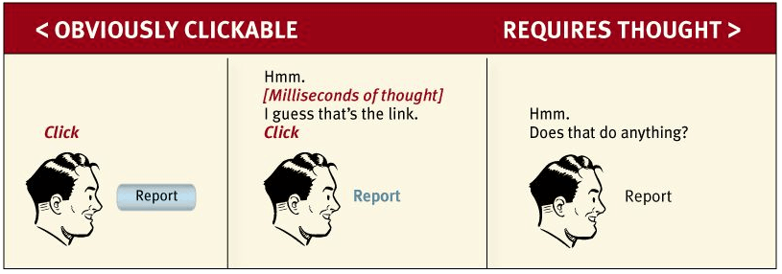
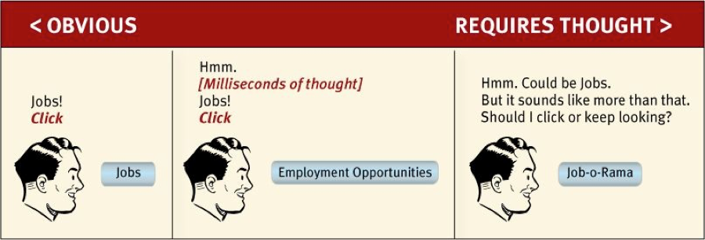
No Thinking
Keep the cognitive workload low
Don’t distract users from the task at hand

Slide 9

No Thinking
Self-evident
Self-explanatory
Notes:
Self-evident:
Should be obvious for the user what the page is about and what the next possible actions are
Self-explanatory:
Some things are difficult. If you cannot make it self-evident, make it self-explanatory.
How?
Appearance of things
Well chosen names
Small amounts of carefully crafted text

Slide 10


User Behavior
Billboard going by at 100km an hour
Glances at the page
Scans some of the text
Click on first thing that might be a hit
Large parts of the page are not observed

Slide 11
User Behavior
Pages are not read, they are scanned
The user is on a mission
Knows she doesn’t need to read everything
Is good at scanning

Slide 12
User Behavior
They don’t choose, they satisfice
Satisfice:
Not picking the best option but the first reasonable one
Notes:
Satisfice
Satisfying (voldoen): giving fulfilment or the pleasure associated with this.
Sufficing (voldoende): be enough or adequate.
Coined by economist Herbert Simon in Models of Man: Social and Rational

Slide 13
User Behavior
Satisficing
We’re in a hurry
No penalty for mistakes
Guessing is fun

Slide 14
User Behavior
Users like mindless choices
Lots of clicks are ok as long as each one is painless and the user has continued confidence she’s on the right track
Notes:
Krug’s second law of usability.
3 mindless, unambiguous clicks equal one that requires thought.

Slide 15
User Behavior
Muddling Through
We don’t care about figuring things out
Once we find something that works, we seldom look for better ways
Notes:
We don’t figure things out:

Slide 16
User Behavior
If users are acting like we’re designing billboards…
Then let’s design great billboards!
Notes:
We don’t figure things out:

Slide 17


Billboard Design
Conventions
Location of Things
Known Metaphors
Standardized Appearance
Clarity Trumps Consistency
Allow to be slightly inconsistent when being significantly clearer
Innovations
Innovate when you have a better idea
Take advantage of conventions when you do not
Notes:
Location of things: footer general info, header menu, …
Metaphors: Shopping Cart, Save Icon, …
Appearance: Social Buttons, Image + Play Icon
Clarity:
Innovate: Should be clear and self-explanatory or adds so much value it is worth the learning curve

Slide 18
Billboard Design
Effective Visual Hierarchies
More Important == More Prominent
Related Logically == Related Visually
Nesting to indicate what is part of what
Notes:
More Prominent: bold, bigger font, distinctive color, …
Related Visually: grouping together, same visual style, in a clearly defined area
Nesting: Cards, Boxes, …

Slide 19
Billboard Design
Break up pages into clearly defined areas
Keep the noise down
Format text to support scanning
Highlight key terms
Notes:
Noise down:
No shouting. Not everything is important. Avoid clutter.
Support scanning:
Headers, bullet points, short paragraphs …

Slide 20
Billboard Design
Omit needless words
Get rid of half the words on each page, then get rid of half of what’s left -- Krug’s Third Law of Usability
Notes:
Reduce noise
Make useful content more prominent
Makes pages shorter (less scrolling, more scanning)

Slide 21
Billboard Design
Omit needless words
Happy Talk must die
Instructions must die
Notes:
Happy Talk: “Welcome to my homepage / to our business”

Slide 22



Billboard Website
Navigation
Each Page
Home Page

Slide 23
Navigation
Reveals what exists
Tells us how to use the site
Persistent
Not on every page (ex: not on payment page)
Contains
Site ID (logo)
Sections
Utilities & Search
Back Home
Notes:
Utilities: Sign In, Contact, …

Slide 24
Each Page
Needs a name
You Are Here
Breadcrumbs
The Trunk Test
Notes:
Trunk Test:
You’ve been kidnapped put in the trunk & then first thing get to see the site
What site is this (site ID)
What page am I on (page name)
What are the major sections
What are my options at this level (local navigation)
Where am I in the scheme of things
How can I search

Slide 25
Home Page
Everyone wants a piece of it
The Big Picture
Tagline
Welcome blurb

Slide 26
Usability Testing

Slide 27
Laws of Usability
1st: Don’t make me think
2nd: It doesn’t matter how many times I have to click, as long as each click is a mindless, unambiguous choice.
3rd: Get rid of half the words on each page, then get rid of half of what is left.
Notes:
Small recap!!

Slide 28
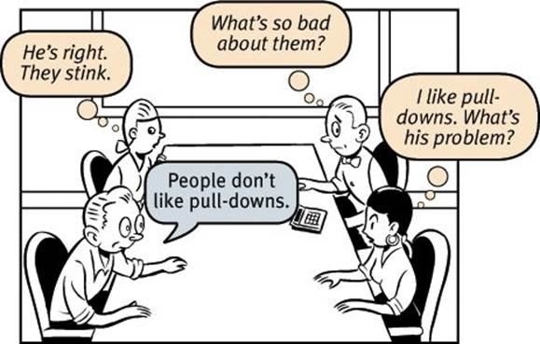
Religious Debates

Slide 29
Religious Debates
The myth of the Average User
There is no substitute for testing
Usability testing: watch a user perform a task
Focus group: 5-10 people talk about things
Test early
Do-it-yourself usability testing
Notes:
Focus group: More an indication for example marketing does not like where the website is going

Slide 30
Do-it-yourself usability testing
There is no budget to outsource it
Once every month
Three people, recruited loosely (but grade them)
Many observers
Half a day, on-site, with screen recording software
Meet over lunch with stakeholders to discuss the results
Identify the most serious problems
Decide what to fix
Notes:
Focus group: More an indication for example marketing does not like where the website is going
DIY: There is typically no budget to these kinds of things (€5 to €10k)…

Slide 31
Usability
as
common courtesy

Slide 32
Reservoir of goodwill
Idiosyncratic
Situational
Refillable
Can be unforgiven
Notes:
Idiosyncratic: Different for every user
Situational: Less when I’m in a hurry
Refill: So something good
Unforgiven: A single mistake and you could lose the user

Slide 33
Reservoir of goodwill
Things that diminish goodwill
Hiding information from me
Asking unneeded information
Punishing me for not doing things your way
Putting sizzle in my way
Amateurish looking websites
Notes:
Punishing: ex: only accepting input in one style (formatted, not formatted, …)

Slide 34
Reservoir of goodwill
Things that increase goodwill
My targets should be easy to find and achieve
Tell me things I want to know
Save me steps whenever possible
Make it easy to recover from errors
When you can’t, apologize for the inconvenience
Provide printable pages
Know questions they might have, and answer them
Notes:
When you can’t: if something is not possible on the website, for whatever reason, apologize.

Slide 35
Other Chapters

Slide 36
Mobile
Not just a city in Alabama anymore
Managing real estate challenges shouldn’t be done at the cost of usability

Slide 37
Guide for the perplexed
Making usability happen
where you live

Slide 38
Accessibility and you
Just when you think you’re done…

Slide 39
More Resources

Slide 40

User Behavior
Muddling Through
The people least capable of running a group or organization are now in charge
And… We are the inmates…
Notes:
Alan Cooper
Interaction Design
FileSystem is not something normal users want to think or even know about.

Slide 41
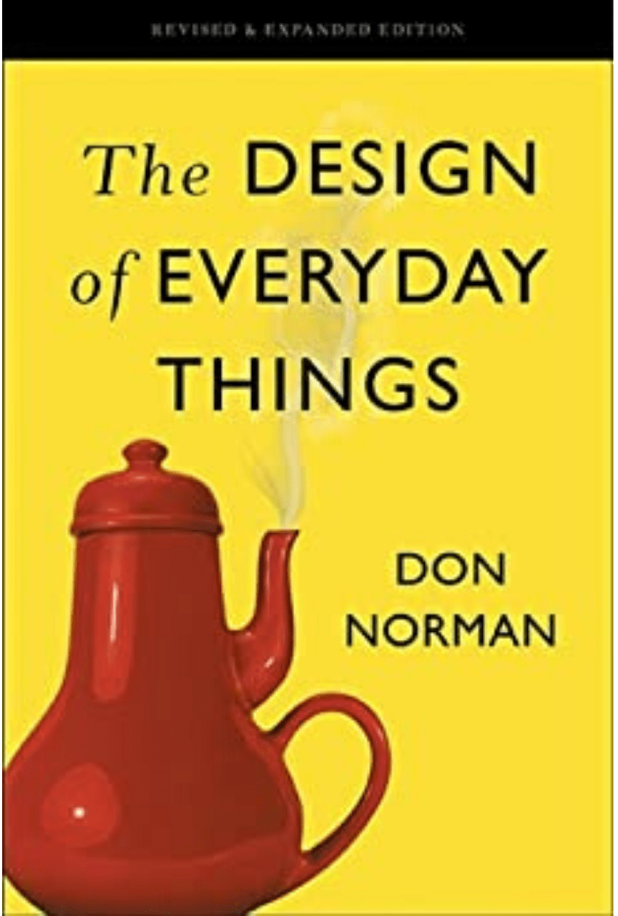
More Resources
The Design of Everyday Things
Mentioned by Krug
Norman Doors
The importance of visual clues

Slide 42
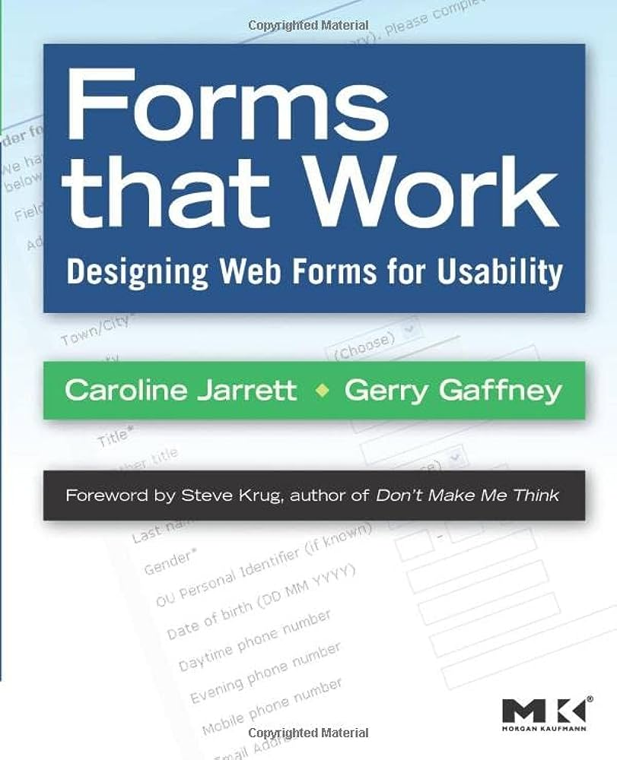
More Resources
Mentioned by Krug
Example “what’s this”, tooltips should be
Brief
Timely
Unavoidable

Slide 43

More Resources
Designing with the Mind in Mind

Slide 44
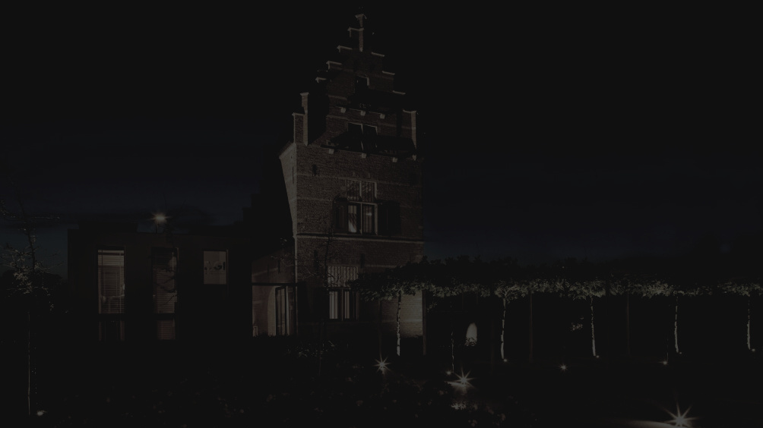


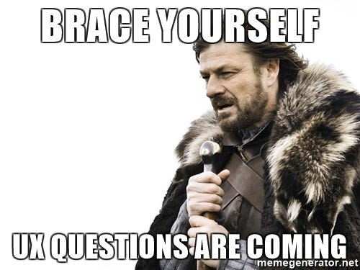
Questions?

Slide 45
THANK YOU!

Slide 46



WiFi: itenium-guest / Wifi4Ufree
New WiFi: ITENIUM_GAST / FreeWifi

